Slide 1

Data Science

Slide 2
0
Introduction

Slide 3
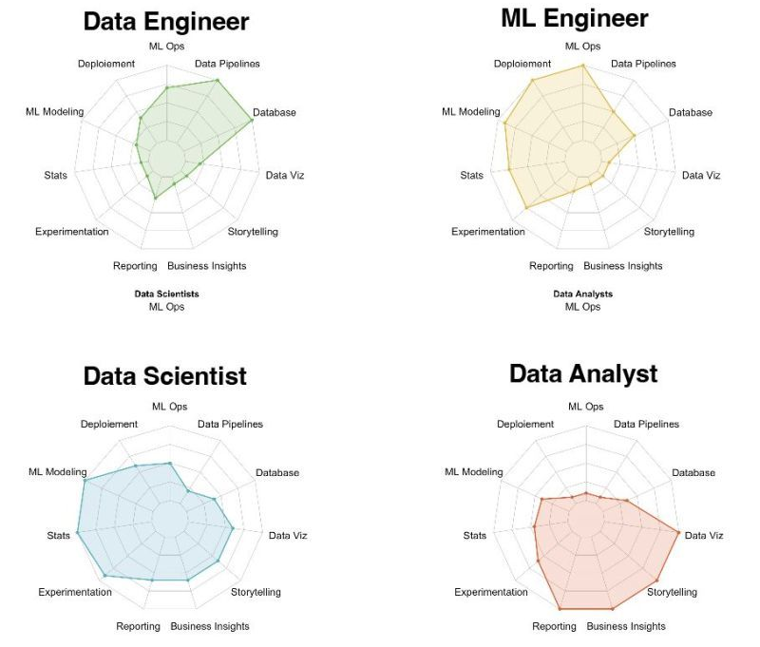
Data Professionals

Slide 4
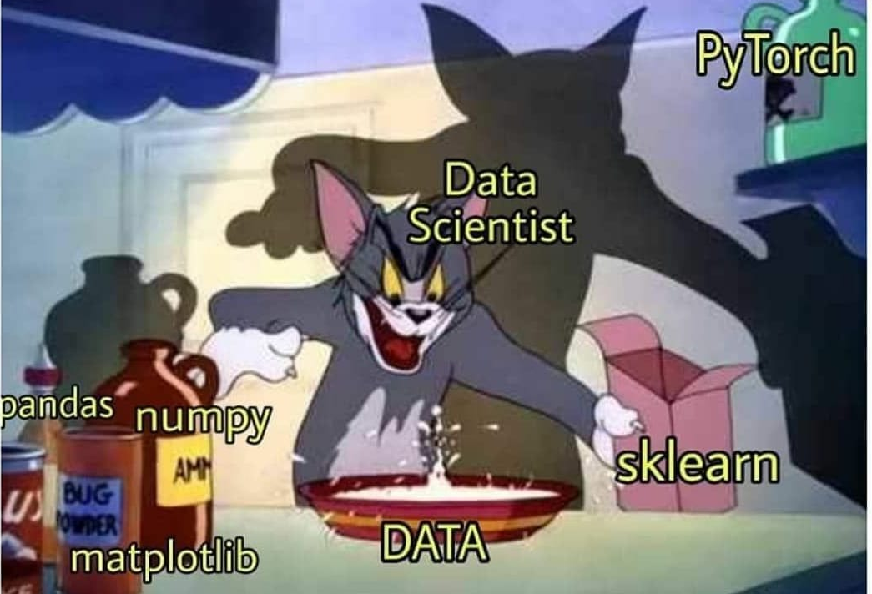
Data Science
A Data Scientist helps companies with data-driven decisions, to make their business better.
Data Science is a combination of multiple disciplines that uses statistics, data analysis, and machine learning to analyze data and to extract knowledge and insights from it.
Data Science is about data gathering, finding patterns in data, data analysis, make future predictions and decision-making.

Slide 5
1
Numpy

Slide 6
Introduction
NumPy stands for Numerical Python.
NumPy is a Python library used for working with arrays. It also has functions for working in domain of linear algebra, fourier transform, and matrices.
NumPy aims to provide an array object that is up to 50x faster than lists. Arrays are very frequently used in data science. The array object in NumPy is called ndarray.
Numpy documentation: https://numpy.org/doc/
Import
import numpy as np

Slide 7
Arrays
Create
arr0 = np.array(1)
arr1 = np.array([1, 2, 3])
arr2 = np.array([[1, 2, 3], [2, 3, 4]])
arr3 = np.array([[[1, 2, 3], [2, 3, 4]], [[3, 4, 5], [4, 5, 6]]])
print(arr2.ndim)
Slice
arr = np.array([[1, 2, 3, 4, 5], [6, 7, 8, 9, 10]])
print(arr[1, 5], arr[1, 1:4], arr[0:2, 1:4])

Slide 8
Data Types
Check
arr = np.array([1, 2, 3, 4])
print(arr.dtype)
Define
arr = np.array([1, 2, 3, 4], dtype = 'S')
print(arr.dtype)
Convert
arr = np.array([1, 2, 3, 4])
newArr = arr.astype('S')
print(arr.dtype, newArr.dtype)
i
f
Integer
u
Float
c
O
V
Object
Void
Unsigned integer
Complex float
S
String
b
Boolean
U
Unicode string
m
Timedelta
M
Datetime

Slide 9
Copy and View
Copy is a new array, and view is just a view of the original array.
arr = np.array([1, 2, 3, 4, 5])
viewArr = arr.view()
copyArr = arr.copy()
arr[0] = 10
print(viewArr, copyArr)
print(viewArr.base, copyArr.base)

Slide 10
Shape
Shape
arr = np.array([[1, 2, 3, 4], [5, 6, 7, 8]])
print(arr.shape)
Reshape
arr = np.array([1, 2, 3, 4, 5, 6, 7, 8])
print(arr.reshape(2, 4))
print(arr.reshape(2, 2, -1))
Flatten
arr = np.array([[1, 2, 3, 4], [5, 6, 7, 8]])
print(arr.reshape(-1))

Slide 11
Loops
Iterating arrays
arr = np.array([[1, 2, 3, 4], [5, 6, 7, 8]])
for x in arr:
print(x)
for x in np.nditer(arr):
print(x)
for x in np.nditer(arr[:, ::2]):
print(x)
for x in np.ndenumerate(arr):
print(x)

Slide 12
Joins and Splits
Joining arrays
arr1, arr2 = np.array([[1, 2], [3, 4]]), np.array([[5, 6], [7, 8]])
print(np.concatenate((arr1, arr2)))
print(np.concatenate((arr1, arr2), axis = 1))
print(np.stack((arr1, arr2), axis = 1))
Splitting arrays
arr = np.array([[1, 2, 3, 4], [5, 6, 7, 8], [9, 10, 11, 12], [13, 14, 15, 16]])
print(np.array_split(arr, 2))
print(np.array_split(arr, 3))
print(np.array_split(arr, 6))
print(np.array_split(arr, 2, axis = 1))

Slide 13
Sort
Sorting arrays
arr = np.array([[1, 3], [2, 4], [6, 4], [4, 0]])
print(np.sort(arr))
Search Sorted
arr = np.array([1, 3, 2, 4, 6, 4, 4, 0])
print(np.searchsorted(arr, 3))
print(np.searchsorted(arr, 5))

Slide 14
Search and Filter
Searching arrays
arr = np.array([[1, 3], [2, 4], [6, 4], [4, 0]])
print(np.where(arr == 4))
print(np.where(arr % 2 == 0))
Filtering arrays
arr = np.array([1, 3, 2, 4, 6, 4, 4, 0])
print(arr[arr % 2 == 0])

Slide 15
Random Numbers
Generate Random Number
print(np.random.rand())
print(np.random.rand(2, 3))
print(np.random.randint(50, 100))
print(np.random.randint(50, 100, size = (2, 3)))
Generate Random Number From Array
print(np.random.choice([3, 5, 7, 9]))
print(np.random.choice([3, 5, 7, 9], size = (2, 3)))
print(np.random.choice([3, 5, 7, 9], p = [0.1, 0.3, 0.6, 0.0]))

Slide 16
Universal Functions
Converting iterative statements into a vector based operation is called vectorization.
It is faster as modern CPUs are optimized for such operations.
ufuncs are used to implement vectorization in NumPy.
x, y = [1, 2, 3, 4], [5, 6, 7, 8]
print(np.add(x, y))
Some useful ufuncs
add() subtract() multiply() divide() power() mod() abs()
sum() cumsum() prod() cumprod() diff()

Slide 17
2
Pandas

Slide 18
Introduction
Pandas is a Python library used for working with data sets.
It has functions for analyzing, cleaning, exploring, and manipulating data.
It allows us to analyze big data and make conclusions based on statistical theories.
It can clean messy data sets, and make them readable and relevant.
Pandas documentation: http://pandas.pydata.org/pandas-docs/stable/
Import
import pandas as pd

Slide 19
Series
A column in a table
calories = [420, 380, 390]
s = pd.Series(calories)
print(s)
print(s[0])
calories = {'day1': 420, 'day2': 380, 'day3': 390}
s = pd.Series(calories)
print(s['day2'])
print(s.loc['day2'])

Slide 20
DataFrames
A table with rows and columns
data = {'calories': [420, 380, 390], 'duration': [50, 40, 45]}
df = pd.DataFrame(data)
print(df['calories'])
print(df[['calories']])
print(df.loc[0])
print(df.loc[[0, 2]])
df = pd.DataFrame(data, index = ['day1', 'day2', 'day3'])
print(df.loc['day2'])
print(df.iloc[1])

Slide 21
Read and Write
Read files
df = pd.read_csv('data.csv')
df = pd.read_excel('data.xlsx')
df = pd.read_json('data.json')
Write files
df.to_csv('data.csv')
df.to_excel('data.xlsx')
df.to_json('data.json')

Slide 22
Analyze
df = pd.DataFrame({'calories': [420, 380, 390], 'duration': [50, 50, 45]})
View
print(df.head())
print(df.tail())
print(df.index)
print(df.columns)
print(df['duration'].value_counts())
Information
print(df.info())
print(df.describe())

Slide 23
Sort and Filter
data = {'calories': [420, 380, 390], 'duration': [50, 40, -45]}
df = pd.DataFrame(data, index = ['day2', 'day3', 'day1'])
Sort
print(df.sort_index())
print(df.sort_values(by = 'calories'))
Filter
df[df['duration'] > 0]
df[df < 0] = -df

Slide 24
Operations
df = pd.DataFrame({'calories': [420, 380, 390], 'duration': [50, 40, 45]})
Stats
print(df.sum())
print(df.sum(axis = 1))
print(df.mean())
print(df.max())
print(df.min())
Apply
print(df.apply(np.cumsum))
print(df.apply(lambda x: x.max() - x.min(), axis = 1))
print(df['calories'].apply(lambda x: x * 2))

Slide 25
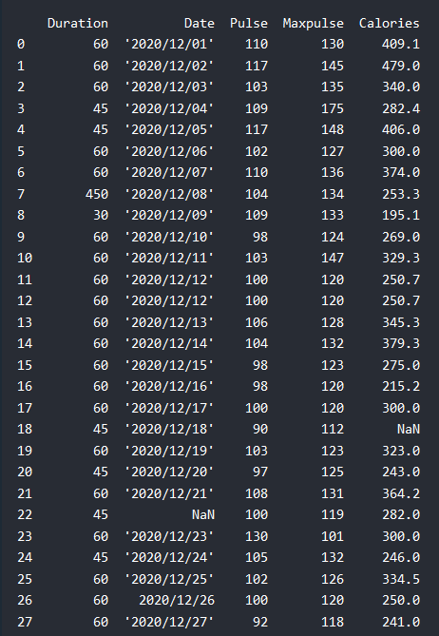
Data Cleaning
The data set contains some empty cells: row 18, 22, and 28.
isna() dropna() fillna()
The data set contains wrong format: row 26.
dtype astype() to_numeric() to_datetime()
The data set contains wrong data: row 7.
loc[] iloc[]
The data set contains duplicates: row 11 and 12.
duplicated() drop_duplicates()

Slide 26
3
Matplotlib

Slide 27
Introduction
Matplotlib is a graph plotting library in python that serves as a visualization utility.
Matplotlib is mostly written in python, a few segments are written in C, Objective-C and Javascript for Platform compatibility.
Most of the Matplotlib utilities lies under the pyplot submodule, and are usually imported under the plt alias.
Matplotlib documentation: https://matplotlib.org/stable/
Import
import matplotlib as mpl
import matplotlib.pyplot as plt

Slide 28
Plotting
xpoints = np.array([0, 10, 8])
ypoints = np.array([0, 15, 4])
Plotting x and y points
plt.plot(xpoints, ypoints)
plt.show()
Plotting without line
plt.plot(xpoints, ypoints, 'o')
plt.show()

Slide 29
Markers and Line
fmt parameter
xpoints = np.array([0, 10, 8])
ypoints = np.array([0, 15, 4])
marker, line, color = '*', '--', 'g'
plt.plot(xpoints, ypoints, f'{marker}{line}{color}')
plt.show
fmt reference
Marker: o * . , x X + P s D d p h H v ^ < > 1 2 3 4 | _
Line: - : -- -.
Color: r g b c m y k w

Slide 30
Markers and Line
Multiple Lines
y1 = np.array([3, 8, 1, 10])
y2 = np.array([6, 2, 7, 11])
plt.plot(y1, marker = '', linestyle = ':', color = '#4CAF50')
plt.plot(y2, 'o-.r', markersize = 9, linewidth = 3)
plt.show()

Slide 31
Text
Title and labels
x = np.array([80, 85, 90, 95, 100, 105, 110, 115, 120, 125])
y = np.array([240, 255, 259, 265, 270, 290, 305, 306, 325, 330])
titleFont = {'family': 'Trebuchet MS', 'color': '#0091EA', 'size': 14}
labelFont = {'family': 'Consolas', 'color': 'black', 'size': 11}
plt.plot(x, y)
plt.title('Sports Watch Data', titleFont)
plt.xlabel('Average Pulse', labelFont)
plt.ylabel('Calorie Burnage', labelFont)
plt.show()

Slide 32
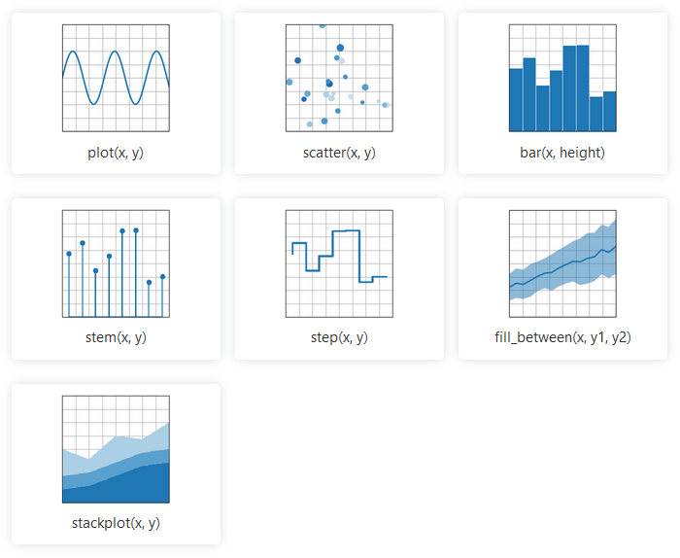
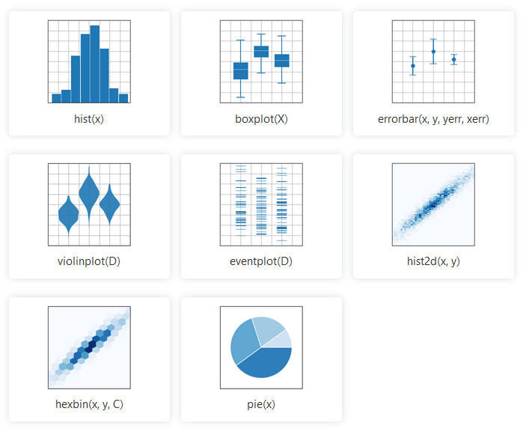
Plot Types
Documentation
https://matplotlib.org/stable/plot_types/index.html

Slide 33
Thanks!
You can find me at:
github.com/AleeRezaa
t.me/Alee_Rezaa
alee_rezaa@outlook.com

